Slide 1
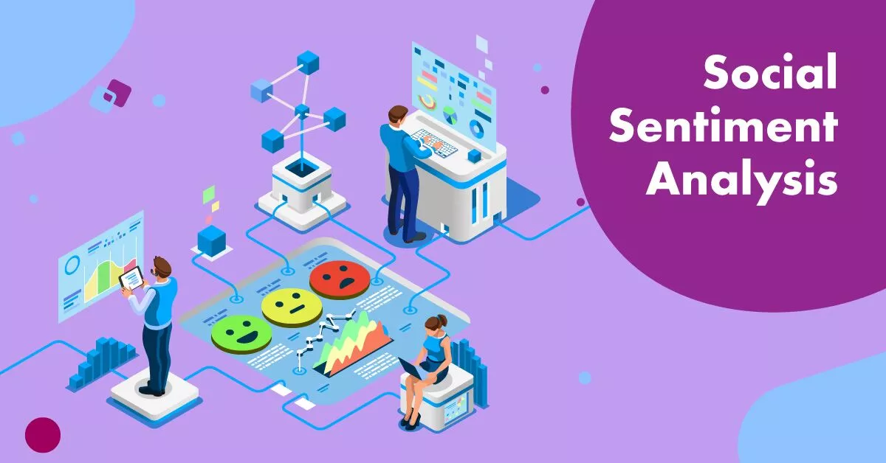

SENTIMENT ANALYSIS For Depression Using Machine Learning AND NLP
Under the Guidance of:
Mrs. Siddhidatri Nayak
(Project Guide)
Submitted By: NIVEDITA A KALEL SAFIYA SAYYAD
PRN NO. 220320528045 220320528001

Slide 2

Problem Statement
Depression is a Medical Condition that affects your mood and ability to function. It has become one of the serious issue across the world.
Detecting earlier depression can be a huge step to address the mental illness and offer support to the people suffering from this terrible mental illness.
Depression can worsen and potentially become fatal if left untreated.

Slide 3


Solution
We need to classify the depressed and non depressed people, to classify these categories we need to collect the text data from social media and apply some machine learning algorithms for classification and predict the depression.
We have got the twitter dataset for prediction of the depression among social media users. The level of depression is classified by the negative sentiment of the user

Slide 4
Working Methodology
DATA COLLECTION
PRE-PROCESSING
FEATURE EXTRACTION
USE OF MACHINE LEARNING ALGORITHMS
GRAPHICAL VISUALIZATION

Slide 5
Results
This is the result table that shows the comparison of different algorithms which are used for classification of sentiments.
Classifier | Training accuracy | Testing Accuracy
Logistic Regression | 86.09 | 73.49
XG Boost Classifier | 77.59 | 73.52
Support Vector machine | 90.83 | 73.94
Random Forest Classifier | 99.26 | 71.56
Decision Tree | 99.26 | 67.75

Slide 6
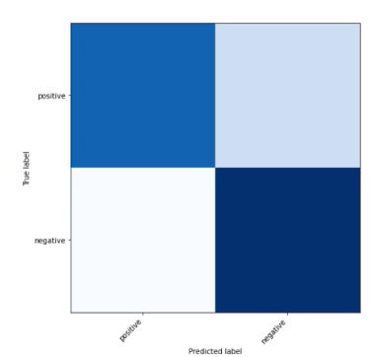
Confusion Matrix

Slide 7
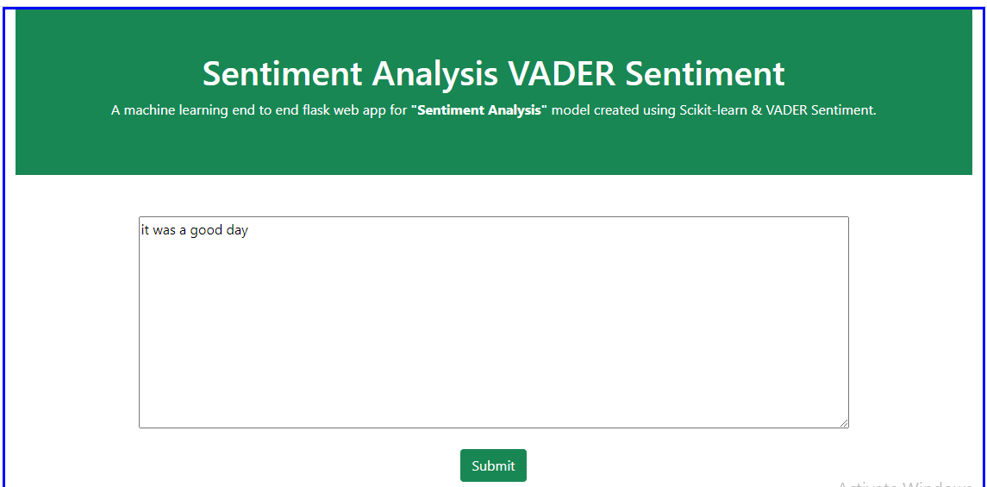
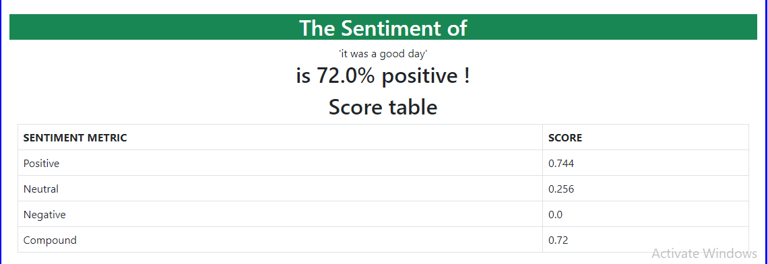
Sentiment Analysis Webpage
http://127.0.0.1:5002/

Slide 8
Future scope
Identification of depression is desirable, so that it can be controlled by giving better counseling at the starting stage itself.
In the future, we will be able to use more models to do analysis of tweets and more social media outlets to determine various mental health issues other than depression such as stress and anxiety.

Slide 9

Thank You

